Slide 1

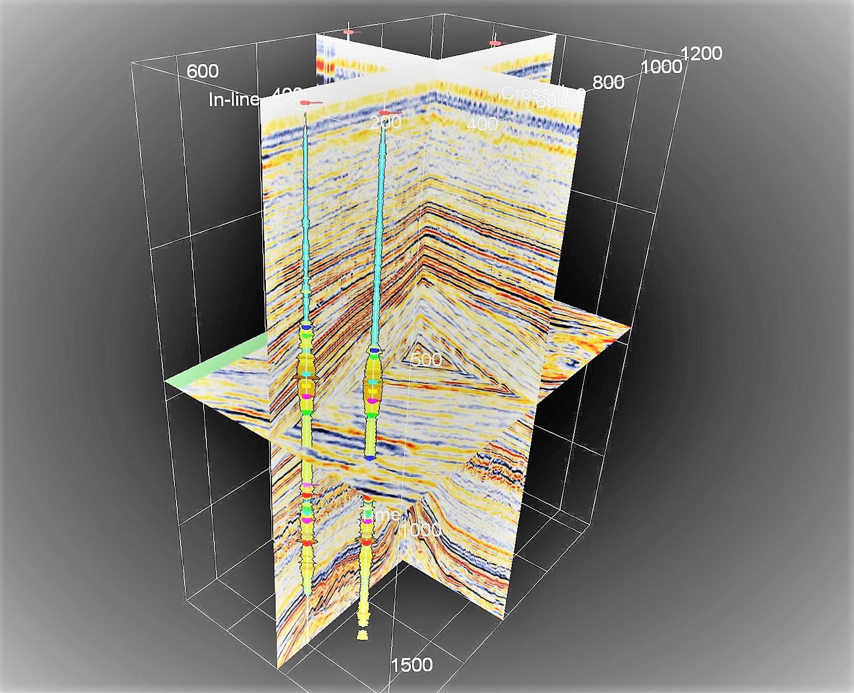
Seismic Spectral Decomposition in Teapot Dome Oilfield
Shiv Mangal Gupta
16je002032

Slide 2
Contents
Introduction to Seismic Spectral Decomposition
Study Area and Field Dataset
Methodology and Workflow
Results and Discussion
Conclusion
References

Slide 3
Introduction to Seismic Spectral Decomposition
Spectral Decomposition is a mathematical tool that helps us in visualizing frequency content of the seismic data along time-axis.
It divides the seismic response of the subsurface into different spectral bands.
y
Sismic Cube
x
freq
Split Spectral Tuning Cube
into Discrete Frequencies
Frequency Slices
through Seismic Cube
(plan view)
Frequency 1
Frequency 2
Frequency 3
Frequency 4
Frequency n
y
y
y
y
y
x
x
x
x
x

Slide 4
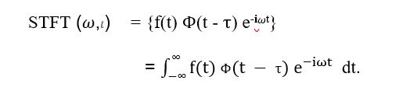

Introduction to Seismic Spectral Decomposition
Spectral decomposition methods used.
Short-Time Fourier Transform (STFT).
Continuous Wavelet Transform (CWT).

Slide 5
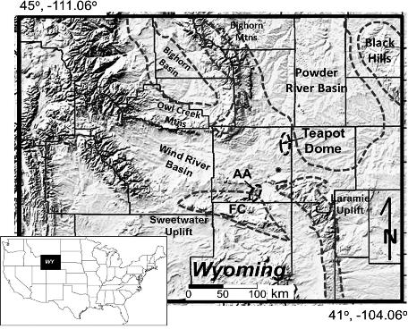
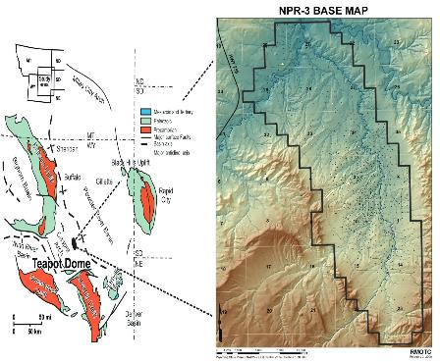
Study Area : Teapot Dome Oilfield
Teapot Dome oilfield is located in Natrona county of central Wyoming state, USA near the southwestern edge of the Powder River Basin.
It is an asymmetrical, doubly plunging, Laramide age anticline.
It is currently under the US Department of Energy
(modified after Cooper et al., 2006).

Slide 6
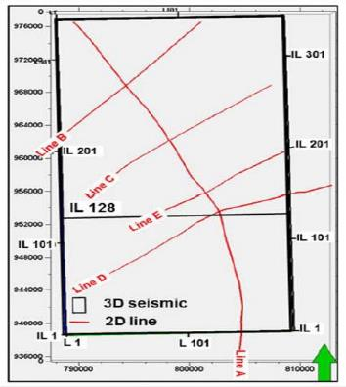
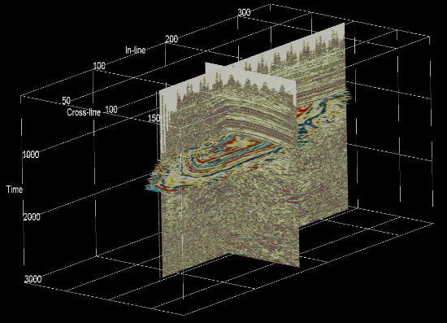

Field Data
The field data is acquired by Rocky Mountain Oilfield Testing Centre (RMOTC) under the project Naval Petroleum Reserve #3.
The dataset contains a 3D seismic cube and five seismic 2D lines (Line - A, B, C, D and E).
Representation of 2D lines and 3D seismic cube (in-line 173, Cross-line 65, time slice-1100ms

Slide 7
Field Data
The field data is acquired by Rocky Mountain Oilfield Testing Centre (RMOTC) under the project Naval Petroleum Reserve #3.
The dataset contains a 3D seismic cube and five seismic 2D lines (Line - A, B, C, D and E).
The 3D seismic data, consist of 345 in-lines and 188 cross-lines with a bin size of 110 ft (33 m). The total coverage of the cube is approximately 70 sq km.
The 2D seismic includes 4 lines of different length in the SW-NE direction. The length of the lines B and C is 5,5 km, line D is 4 km and line E is 7,5 km. In addition, one cross-line along the anticline (line A) has a length of approximately 13 km

Slide 8
Methodology and Work Flow for Seismic Spectral Decomposition
y
3D seismic volume was time sliced between 1050ms and 1060ms.
Analysis of the geological features in each time slice was carried out.
A major fault like structure was observed based on the time slice analysis which was prominent between 1080ms and 1120ms.
x
z
3-D Seismic Volume
Interpret
y
x
Interpreted
3-D Seismic Volume
z
Subset
y
Zone-of-Interest
Subvolume
x
z
Compute
y
Zone-of-Interest
Seismic Cube
(cross-section view)
x
freq
Animate
y
Frequency Slices
through Seismic Cube
(plan view)
x
freq

Slide 9
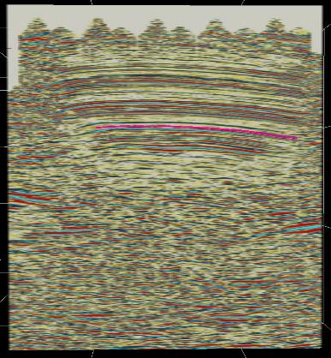
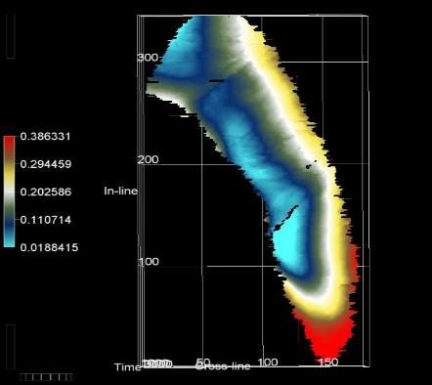

Methodology and Work Flow for Seismic Spectral Decomposition
On the basis of above interpretation I picked an horizon on the 3D seismic data.

Slide 10
Methodology and Work Flow for Seismic Spectral Decomposition
The amplitude spectrum of the seismic data was observed with respect to the picked horizon.
The colour blended seismic data is converted into frequency domain by mathematical transformations.
For transformations, I used Fast Fourier Transform (FFT) and Continuous Wavelet Transform (CWT) algorithms.

Slide 11
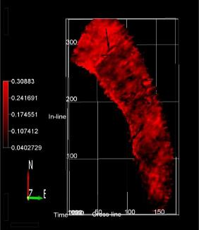
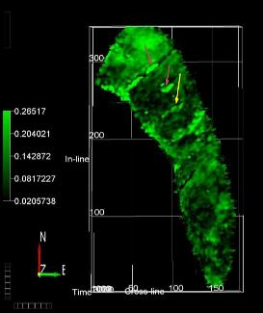
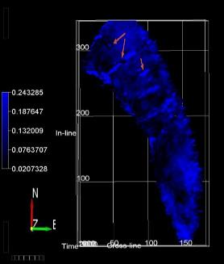
Methodology and Work Flow for Seismic Spectral Decomposition
Then I used Spectral Decomposition to separate the seismic broadband into different frequencies (30Hz, 40Hz and 50Hz) to prepare iso-frequency responses.

Slide 12
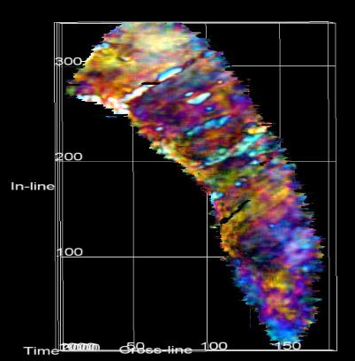
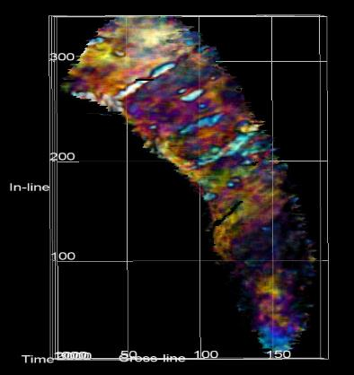
Methodology and Work Flow for Seismic Spectral Decomposition
Iso-frequency images were stacked to form RGB colour blended display.
Then Minimum Similarity Attribute were used to Enhance the display.
RGB colour-blended display
RGB colour –blended display with minimum similarity

Slide 13


Results and Discussion
The major fault was observed at each frequency band during the spectral decomposition.
The fault structure was enhanced in RGB colour blended image having NNE-NSW directional feature.

Slide 14

Results and Discussion
A channel having the NE-SW orientation is observed on the central part of the horizon.

Slide 15

Results and Discussion
The karts features were identified at northern and central part of the horizon.

Slide 16
Conclusions
Mixing outputs of various frequencies allows the analysis of findings that show g-eological characteristics associated with different geometric scales.
Around the same time, higher frequencies show characteristics in greater detail than those of lower frequencies.

Slide 17
Conclusions
The Karts features interpreted on the horizon were more highlighted at particular frequencies.
In northern part feature was enhanced at 50Hz and was barely identifiable at 30 and 40Hz.
In central part this feature was more highlighted at 30 and 40Hz

Slide 18
Conclusions
On correlating the structural features interpreted over the horizon with previous studies and research works on the data. The major fault identified on the horizon is one of the region for hydrocarbon entrapment.
In addition to sharpening of faults, Spectral Decomposition also highlighted geologic features other than faults and channels, such as karst features.
Minimum Similarity based on spectral decomposition cubes revealed faults and karst features at different frequencies and could delineate anomalies otherwise buried in broadband data.

Slide 19
References
Castagna, J. P., S. Sun, and R. Siegfried, 2002, The use of spectral decomposition as a hydrocarbon indicator: Gas TIPS, Summer Summer, 24-27.
Chakraborty A, Okaya D (1995) Frequency-time decomposition of seismic data using wavelet-based methods. Geophysics 60: 1906-1916.
Cooper, S. P., L. B. Goodwin, and J. C. Lorenz, 2006, Fracture and fault patterns associated with basement cored anticlines: The example of Teapot Dome, Wyoming: AAPG Bulletin, 90, 1903–1920,
Partyka GA, Gridley J, Lopez J (1999) Interpretational applications of spectral decomposition in reservoir characterization. The Leading Edge 18: 353-360.
Sinha S, Routh PS, Anno PD, Castagna JP (2005) Spectral decomposition of seismic data with continuous-wavelet transform. Geophysics 70: 19-25.

Slide 20
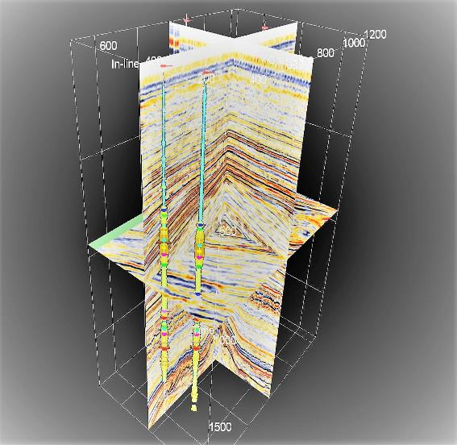
Thank You

